Slide 1
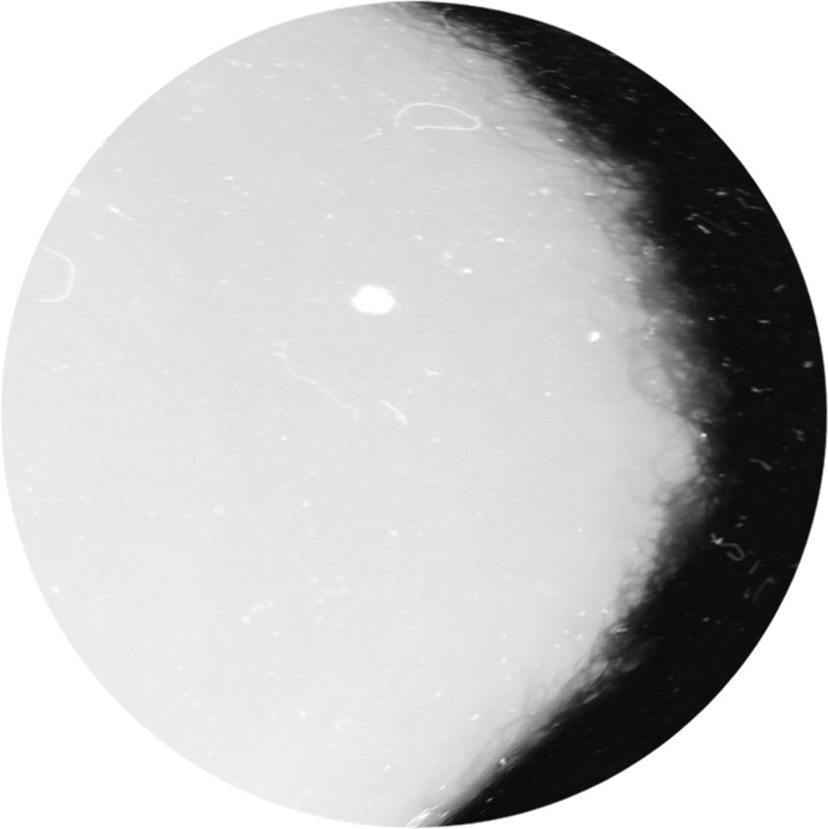
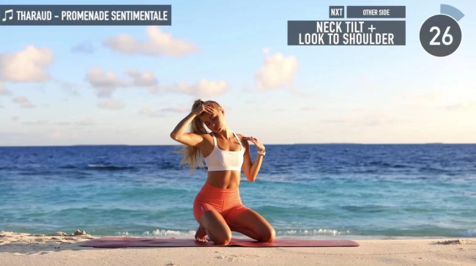




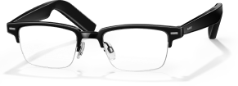
Easy X: A multimodal approach for video progress control
“Makes online exercising easier”
Group3:Chengrui Fang,Xinyuan Jin,Xinyi Zhou,Xulin Huang,Yi Wen

Slide 2
BACKGROUND
Phenomenon
Young people lack exercise
Follow videos online to exercise
Reason
No time
Quarantine

Slide 3
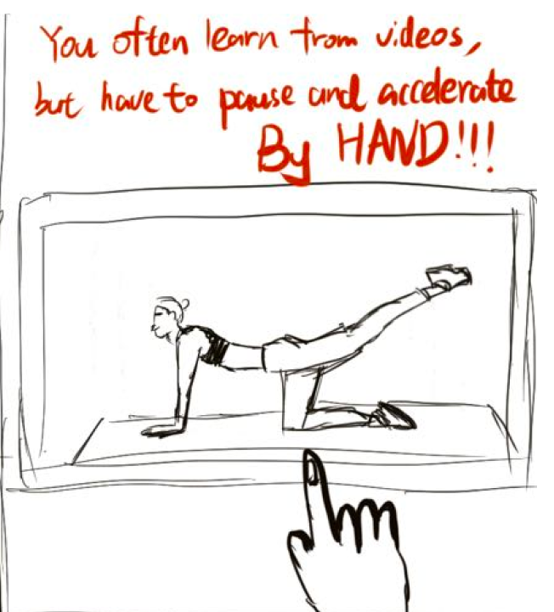
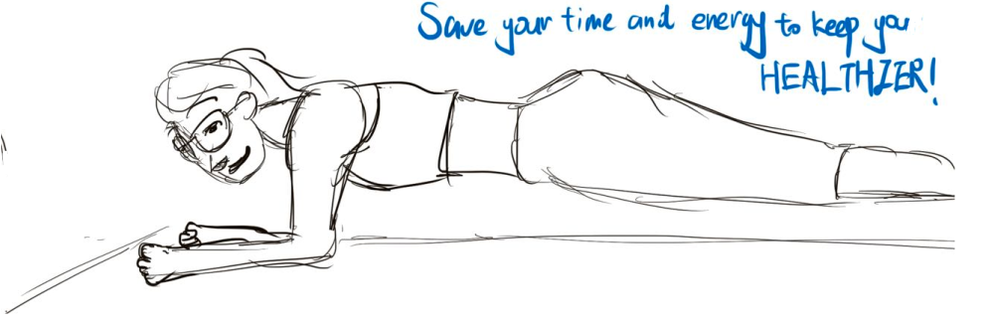
SCENARIO ANALYSIS
Scenario
Digital task | Watch what sports blogger does in the video
Physical task | Mimic the movements in the video
Pain points | 1.Wanna rewind to check if the movement meet the standard 2.Wanna fast forward to adjust the intensity of exercise according to one’s own physical ability 3.Troublesome to perform operations on the screen when doing exercise
Design change | Use voice/gesture/head motion to control the video progress through huawei smart glass

Slide 4
IDEA & CONCEPT
Naming
Easy “X”➡exercise
Motivation
Use multimodal approach for video progress control to improve user experience under online exercising scenario
Target user
People who have to/prefer following online video to do exercise

Slide 5
FUNCTION DESIGN
Video progress control
input
Voice
Touch
Head motion
Time-based control
Motion-based control
Record-based control
Motion-based control
Motion-based control
output
side bend
spine twists
intro
pigeon
3 kinds of output effect

Slide 6
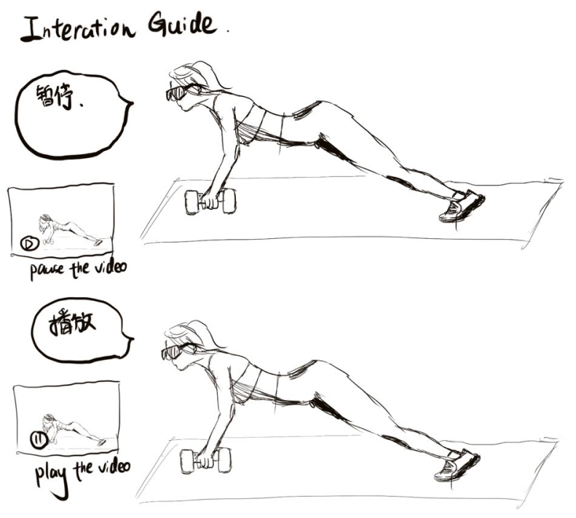
FUNCTION1
Voice control—If you aren’t able to free up your hands，just use your voice
01
03
Time based
Record based
02
Motion based
say “stop”,“continue”,“go on”,“go down”
say“mark”,“arrive”
say“last”,“next”,“again”

Slide 7
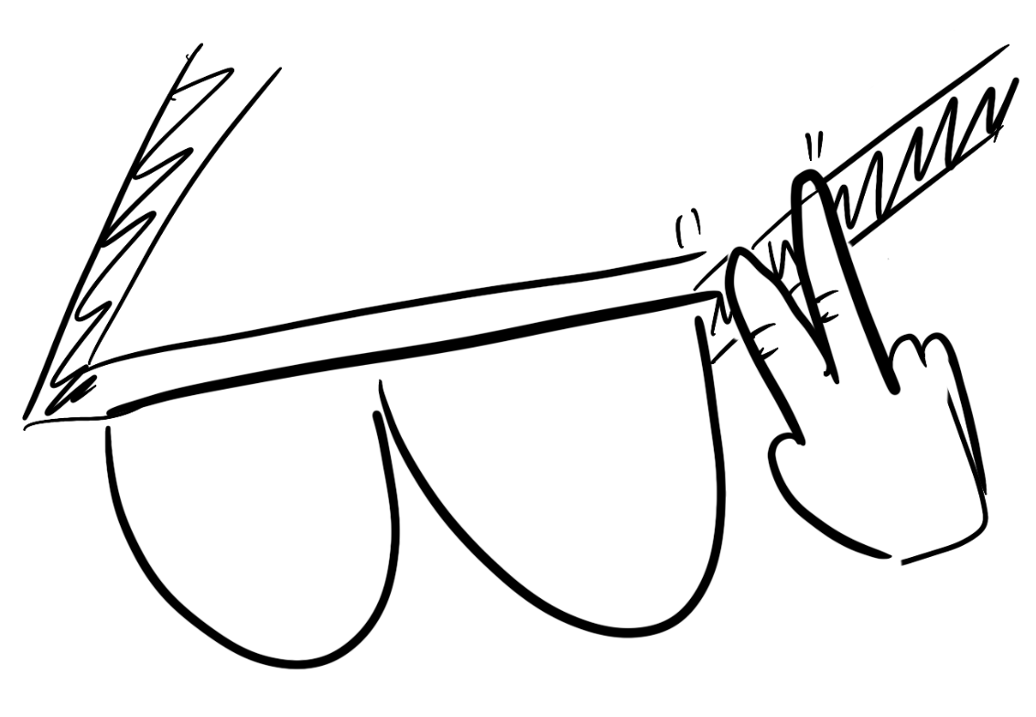
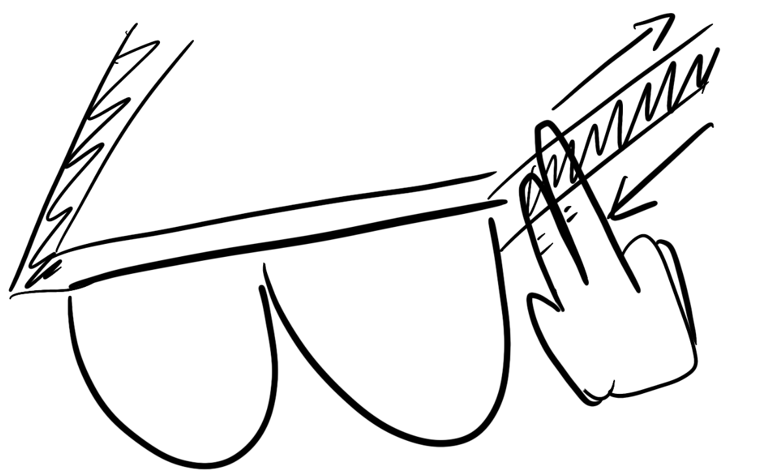
FUNCTION2
Gesture control— If you don't want to make a sound，just use your hand
01
Time based
02
Motion based
Double tap to achieve the effect of “stop”/“continue” voice command
Swipe on the right eyeglass leg to achieve the effect of “last”/“next” voice command

Slide 8
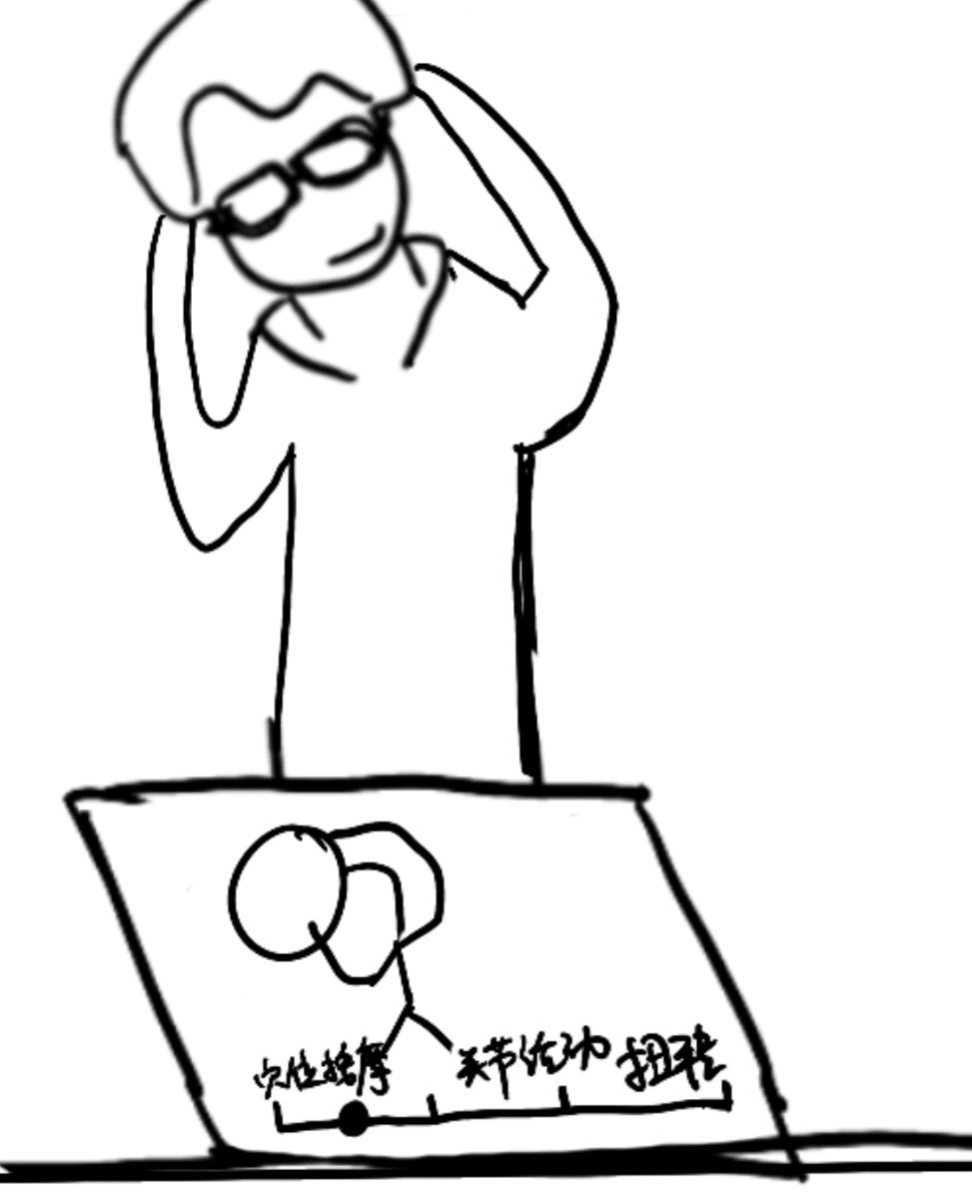
FUNCTION3
Head Motion control— If you want to jump to a specific movement, just do it first
01
Motion based
Make a specific movement, the progress bar will jump to the corresponding one in the video

Slide 9

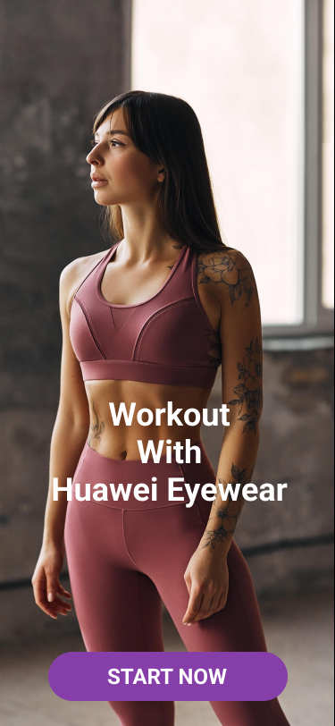
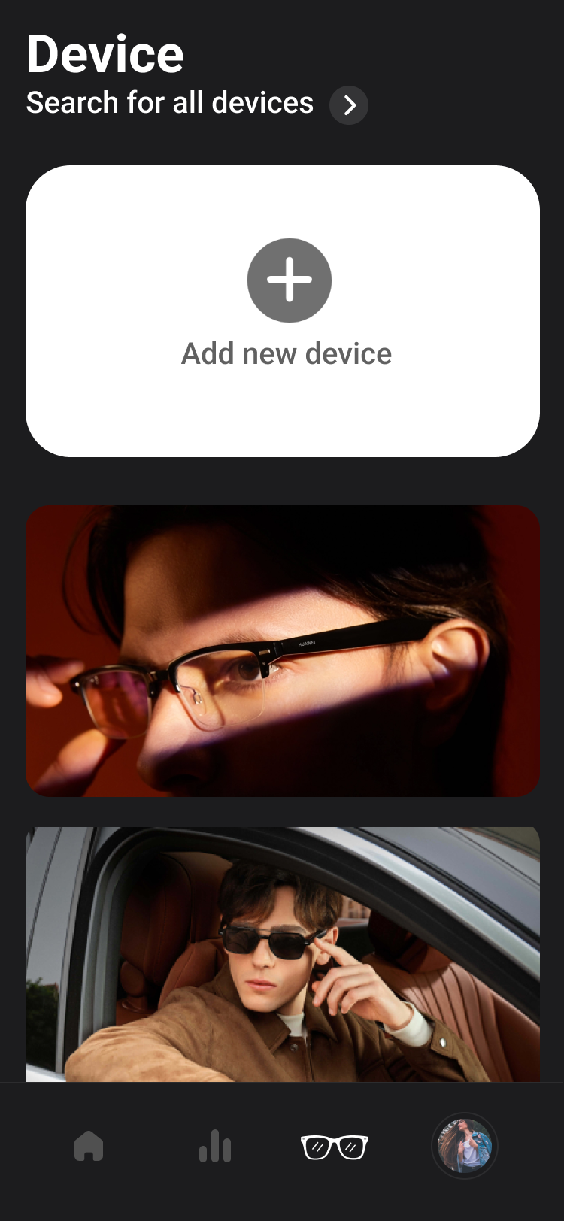
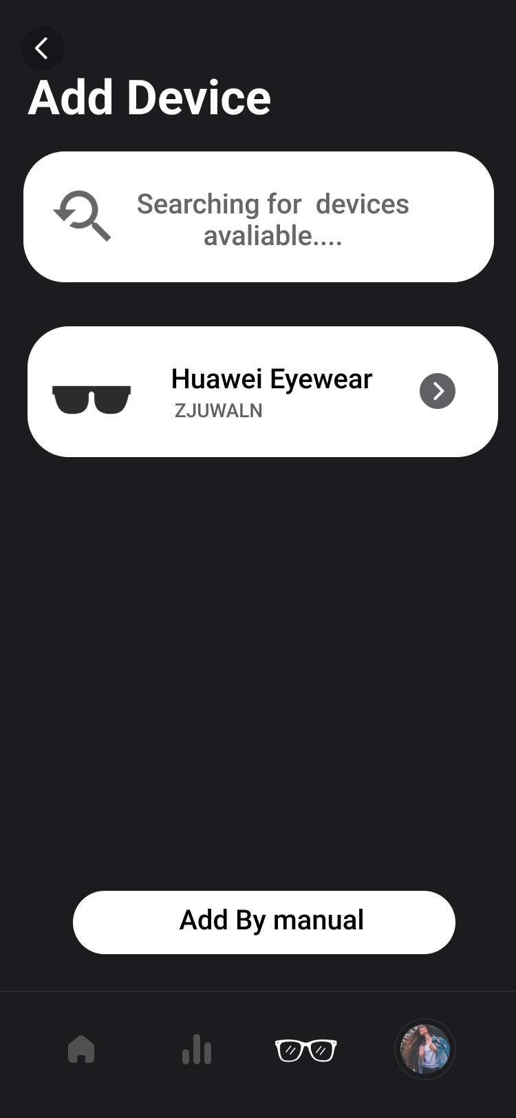
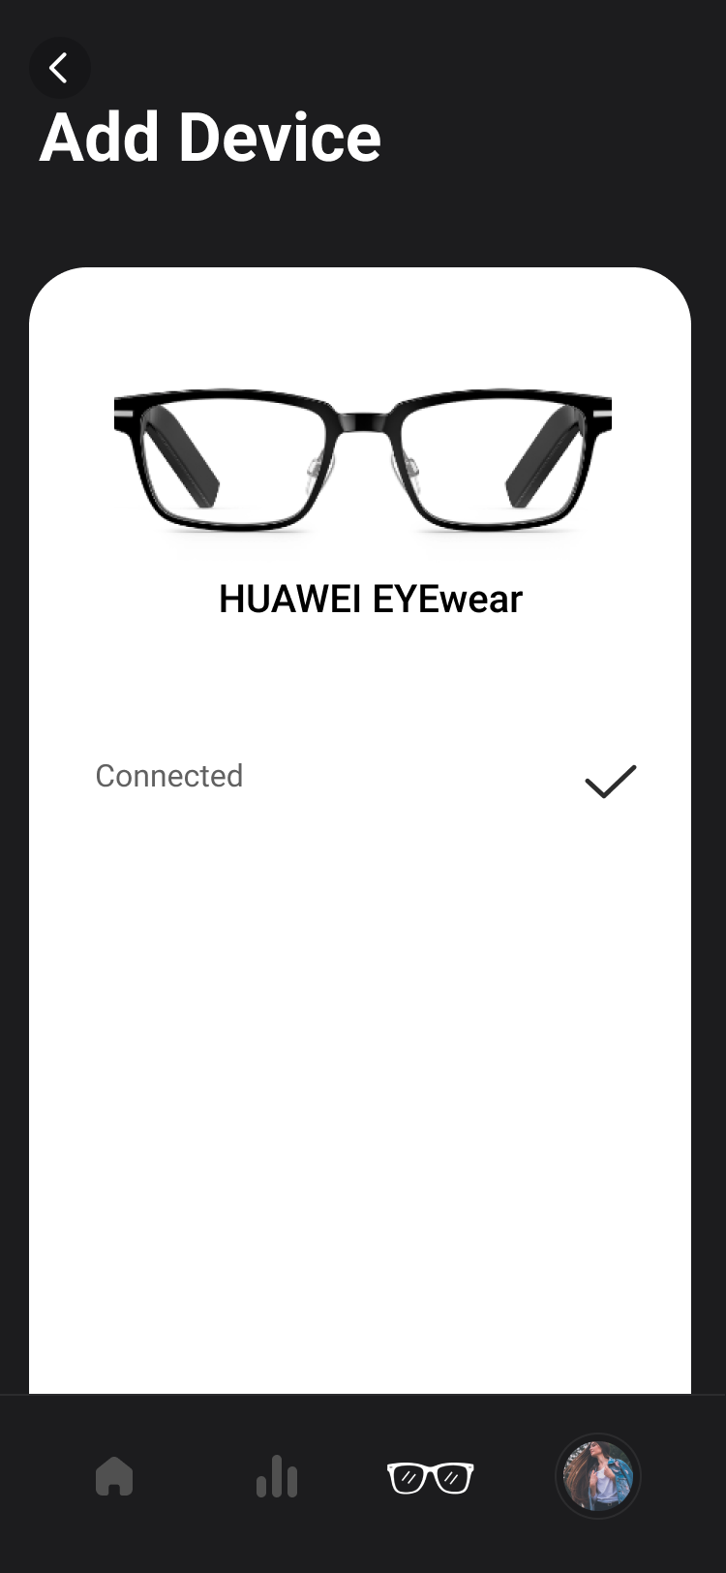
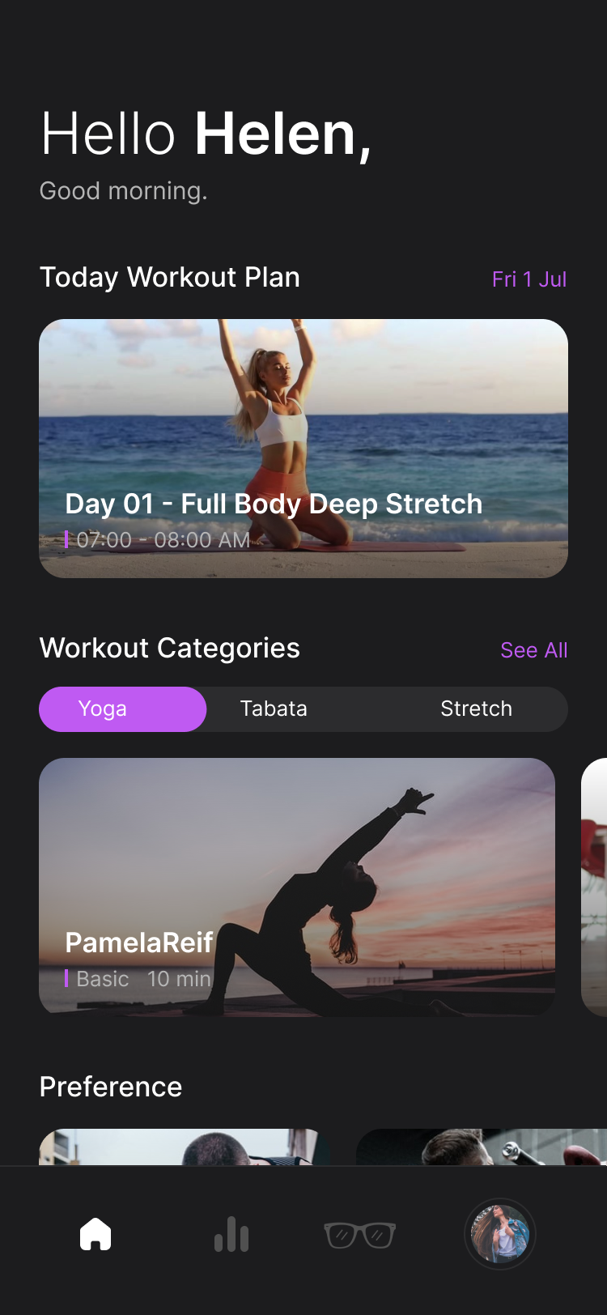
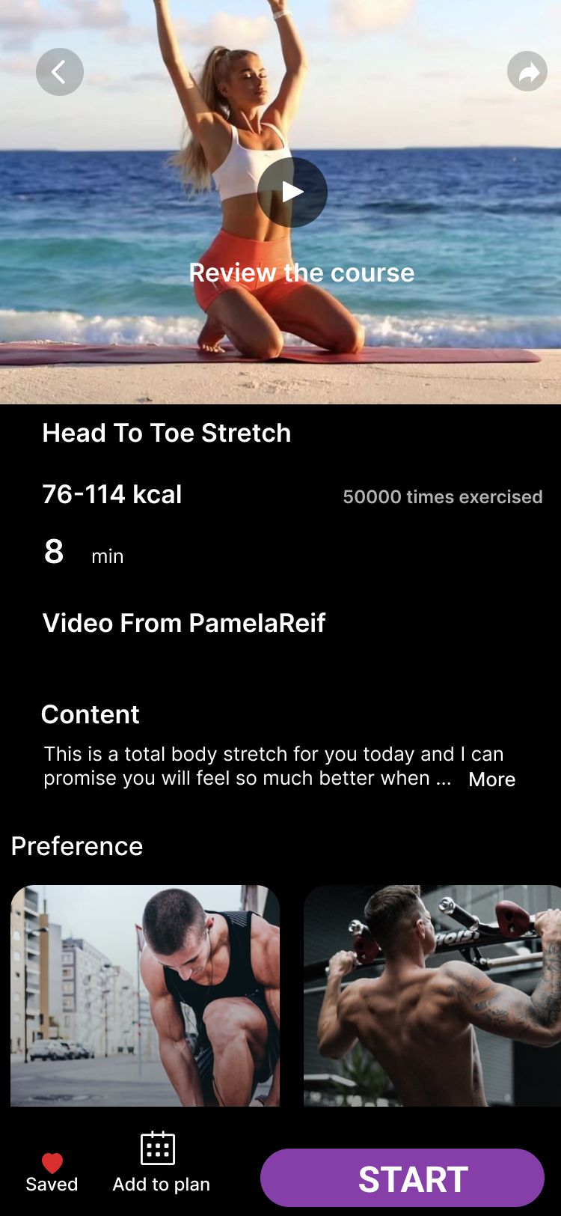
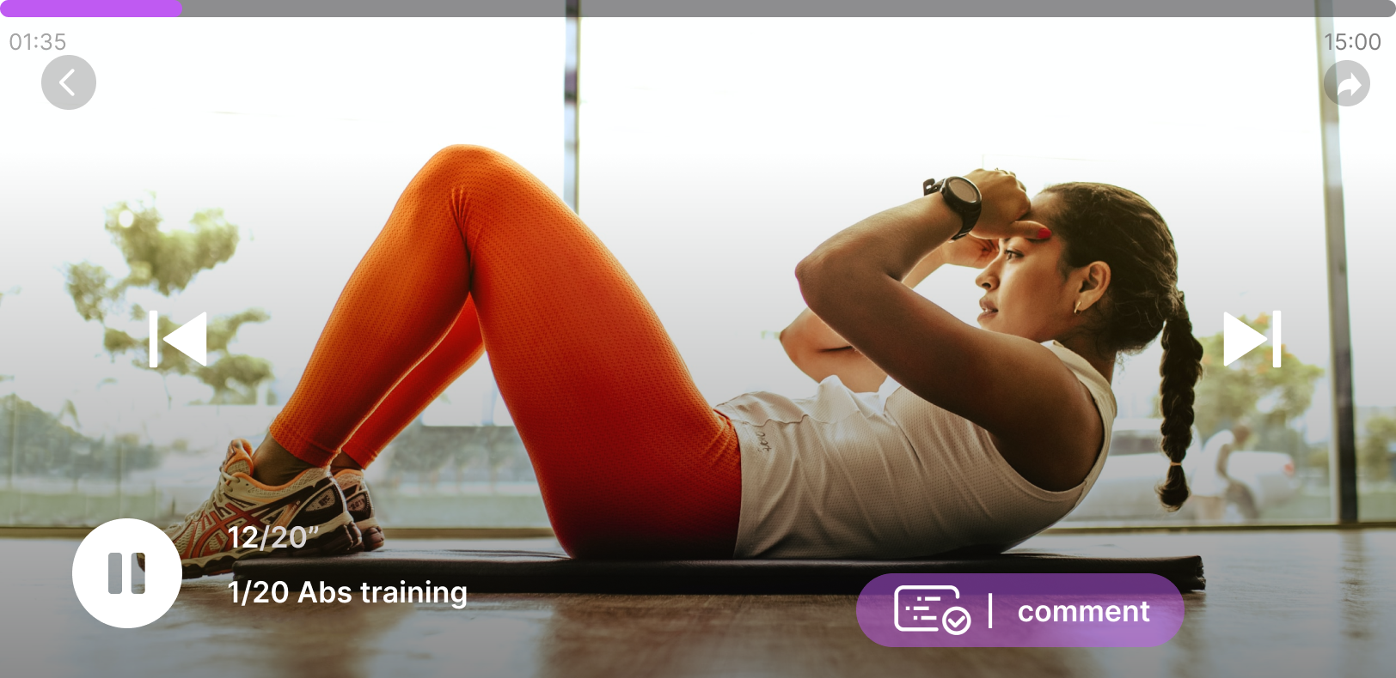
UI DESIGN

Slide 10
Demo video

Slide 11
DISCUSSION
Limitation
Future directions
Accuracy of head posture judgement
Comfort level
Improve the accuracy of posture judgement
Broader Applications of this feature

Slide 12
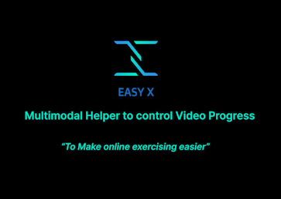
THANKS!
Do you have any questions?
Please keep this slide for attribution

